Slide 1
Online Air Reservation System
Nishu Akter
ID:UG02-48-18-017
State University Of Bangladesh
Department Of Computer Science And Engineering

Slide 2
Abstract
Airline Reservation System contains the details about flight schedules and its fare tariffs, passenger reservations and ticket records. An airline’s inventory contains all flights with their available seats.
The project contains a proposal for development of a web application with the purpose of providing the virtual and real time information about online air reservation system and providing the application for customer to book online and make their own travel plan easier than the traditional way.

Slide 3
Outline
1.INTRODUCTION
2.OBJECTIVES OF PROJECT
3.LITERATURE REVIEW
4.TECHNOLOGIES USED
5.FEATURES
6.OVERVIEW
7.CONCLUSION AND FUTURE WORK
8.ACKNOWLEDGMENT
9.GREETINGS

Slide 4
Introduction
The airline reservation system is a web-based booking solution that helps in consolidating data from all airlines through the use of global distribution systems. The system provides inventory and rates in real time to customers as well as travel agents. Clients can provide details about the number of attendees, arrival and departure dates, and important travel demands all at once, eliminating the need for back-and-forth phone calls and email. This project is designed with the purpose of providing all potential travelers with the virtual and necessary information

Slide 5
Objectives of project
To provide online reservation system for booking air ticket and give the actual status of their booking
To provide the accurate information about the flight detail that they will take, for example the flight number and the time of departure.
To reduce expense and also save time for customers to contact travel agency

Slide 6
Literature review
Airline reservation systems are used to maintain records of flight schedules and passenger reservations and seat assignments and ticket purchases. The modern airline reservation system also serves customer needs from beginning to end of each customer's reserved flight, therefore laying out management tasks for each flight. Airlines created their own systems for ticket booking and management. Today, many brands co-operate with the world airlines companies for user-friendly direct systems, increased productivity and efficiency.

Slide 7
FEATURES
Online bookings in real time.
Various currencies and languages.
Voucher generation and management via the online booking system.
Payment via PayPal.
Intelligent calendar/diary.
Online and telephone support for booking software. .
Automated e-mails make management easier.

Slide 8
TECHNOLOGIES USED
HTML
CSS
PHP
BOOTSTRAP

Slide 9
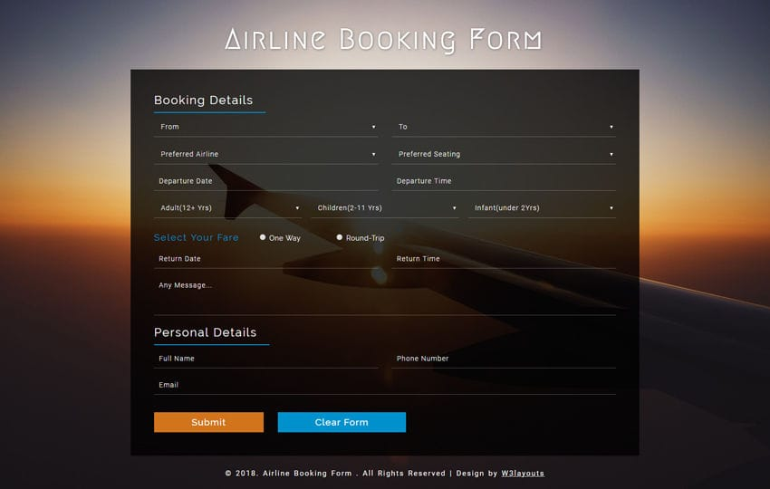
OVERVIEW

Slide 10
Conclusion and future Work
Online ticket booking system has been developed successfully. System performance is also found to be satisfactory. This is a user-friendly application. Through this application, the cost can be reduced and efficiency is increased. There are several procedures that can be selected by customers.
To provide online enquiry about the flights, fare and waiting list status
To perform cancellation of tickets by accepting PNR number from the user and print the refund receipt.
Updating seat plan and verification

Slide 11
Acknowledgment
I would like to thank my honourable khan.Md.Hasib Sir for his time, generosity and critical insights into this project.

Slide 12


